Slide 1
Computer Vision with Embedded Machine Learning
Embedded ML Applications

Slide 2
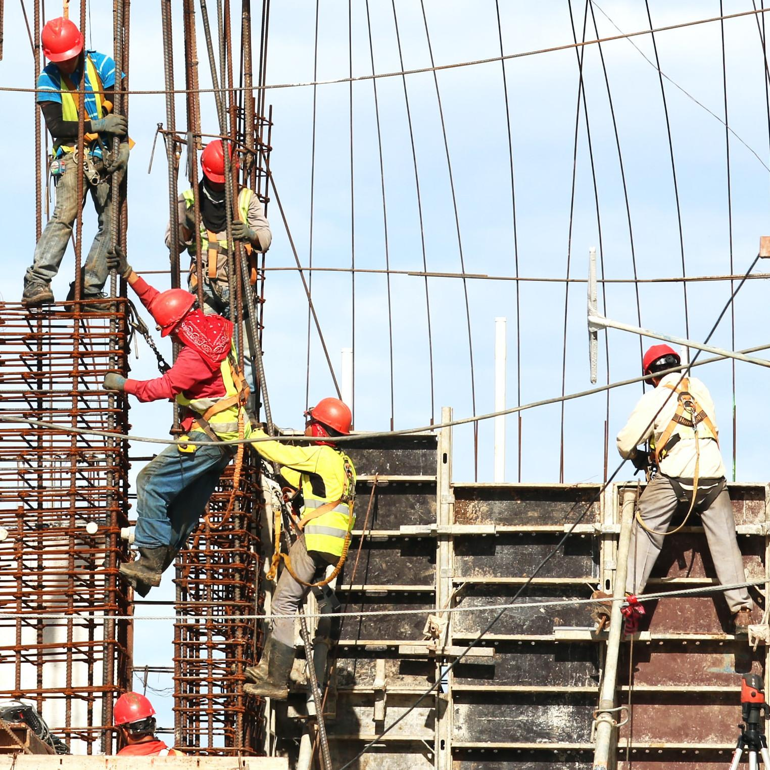

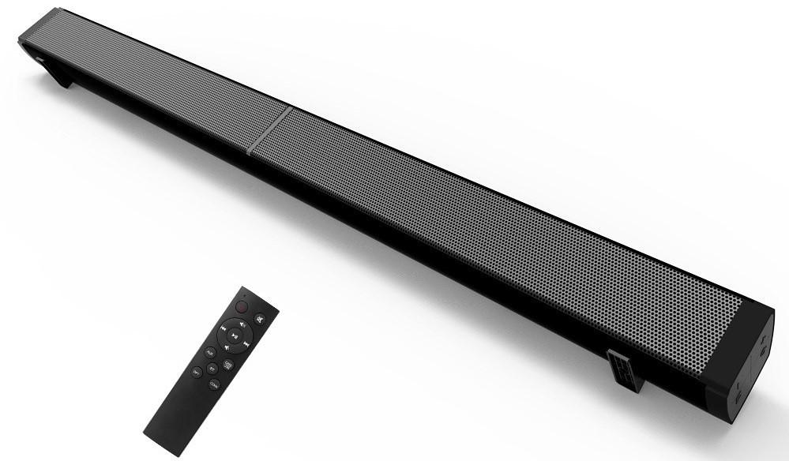

Industry
Hard hat detection
Wearables
Smart Beamforming
“LP-09 Sound Bar Subwoof BT Speaker (2)” by GEEK KAZU is licensed under CC BY 2.0

Slide 3

Education
Areas of study
AI/ML
Embedded systems
Digital signal processing
Tiny Machine Learning Open Education Initiative
tinyml.seas.harvard.edu/
MOOCs
Courseware
Edge Impulse University Program
edgeimpulse.com/university
Courseware
Kit giveaways

Slide 4
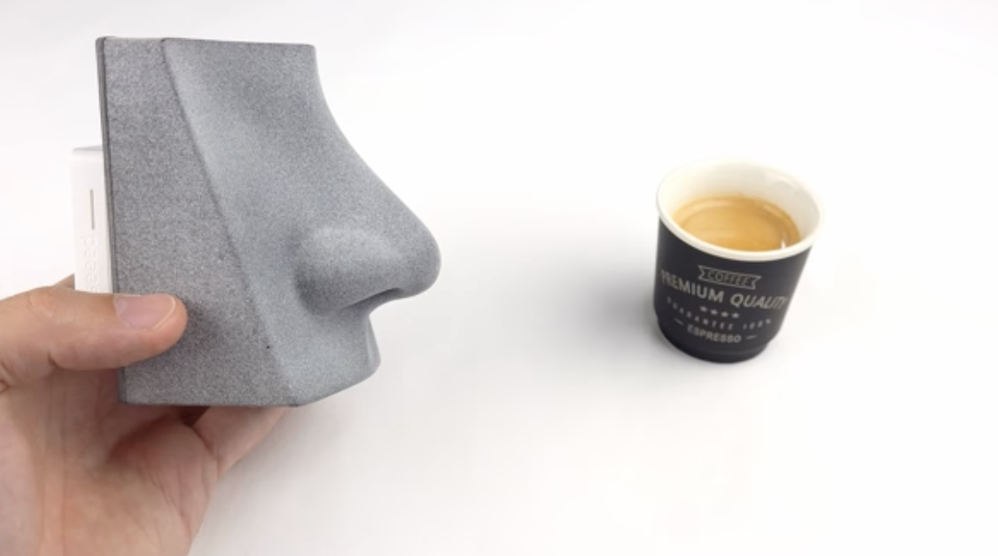
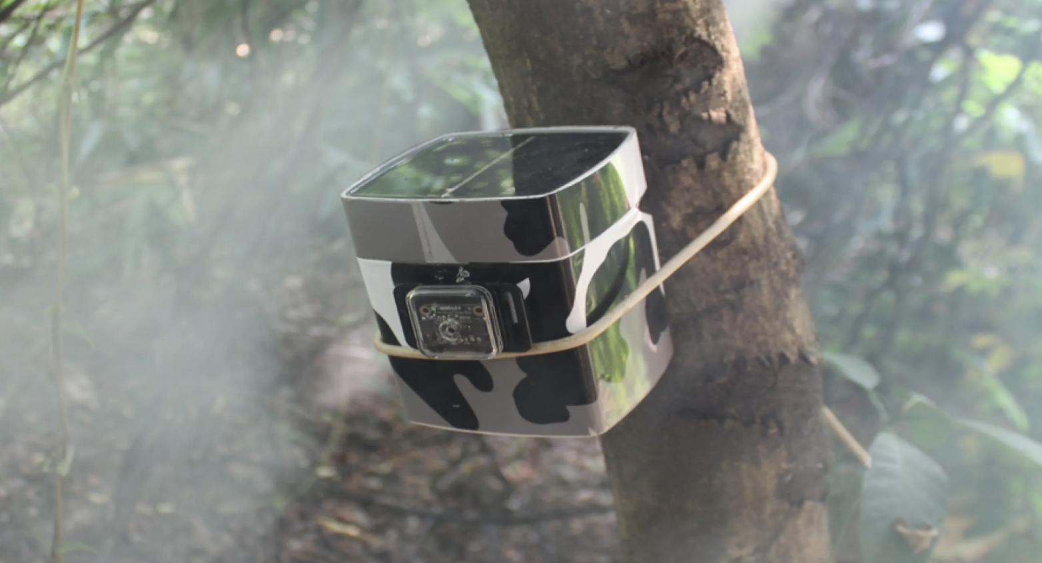
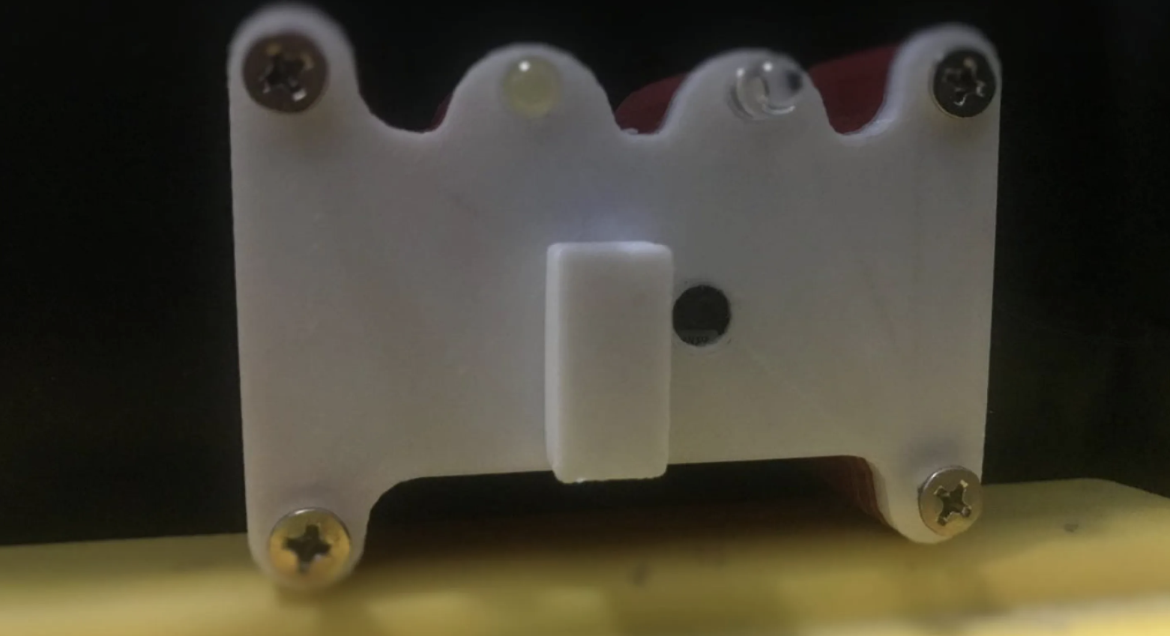
Projects
AI nose
Wildfire detection
Sewer fault detection
blog.benjamin-cabe.com/2021/08/03/how-i-built-a-connected-artificial-nose
edgeimpulse.com/blog/forest-fire-wildfire-detection-powered-by-edge-impulse
edgeimpulse.com/blog/tinyml-is-going-down-the-drain-tinysewer-is-a-low-power-sewer-faults-detection-system

Slide 5
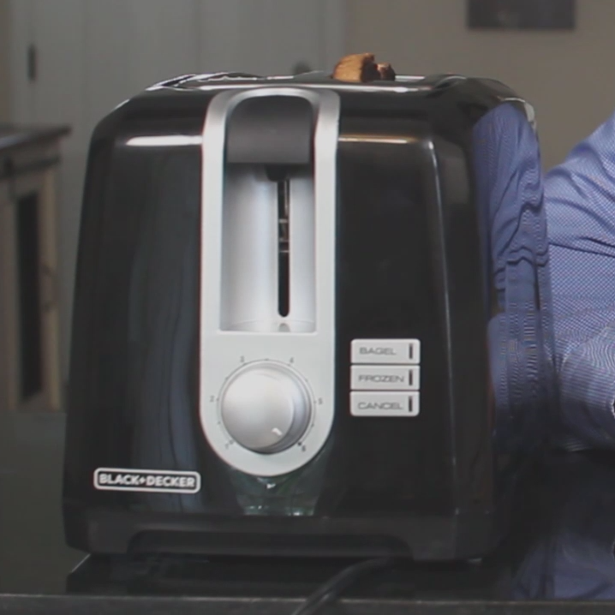
Arbitrary timer

Slide 6
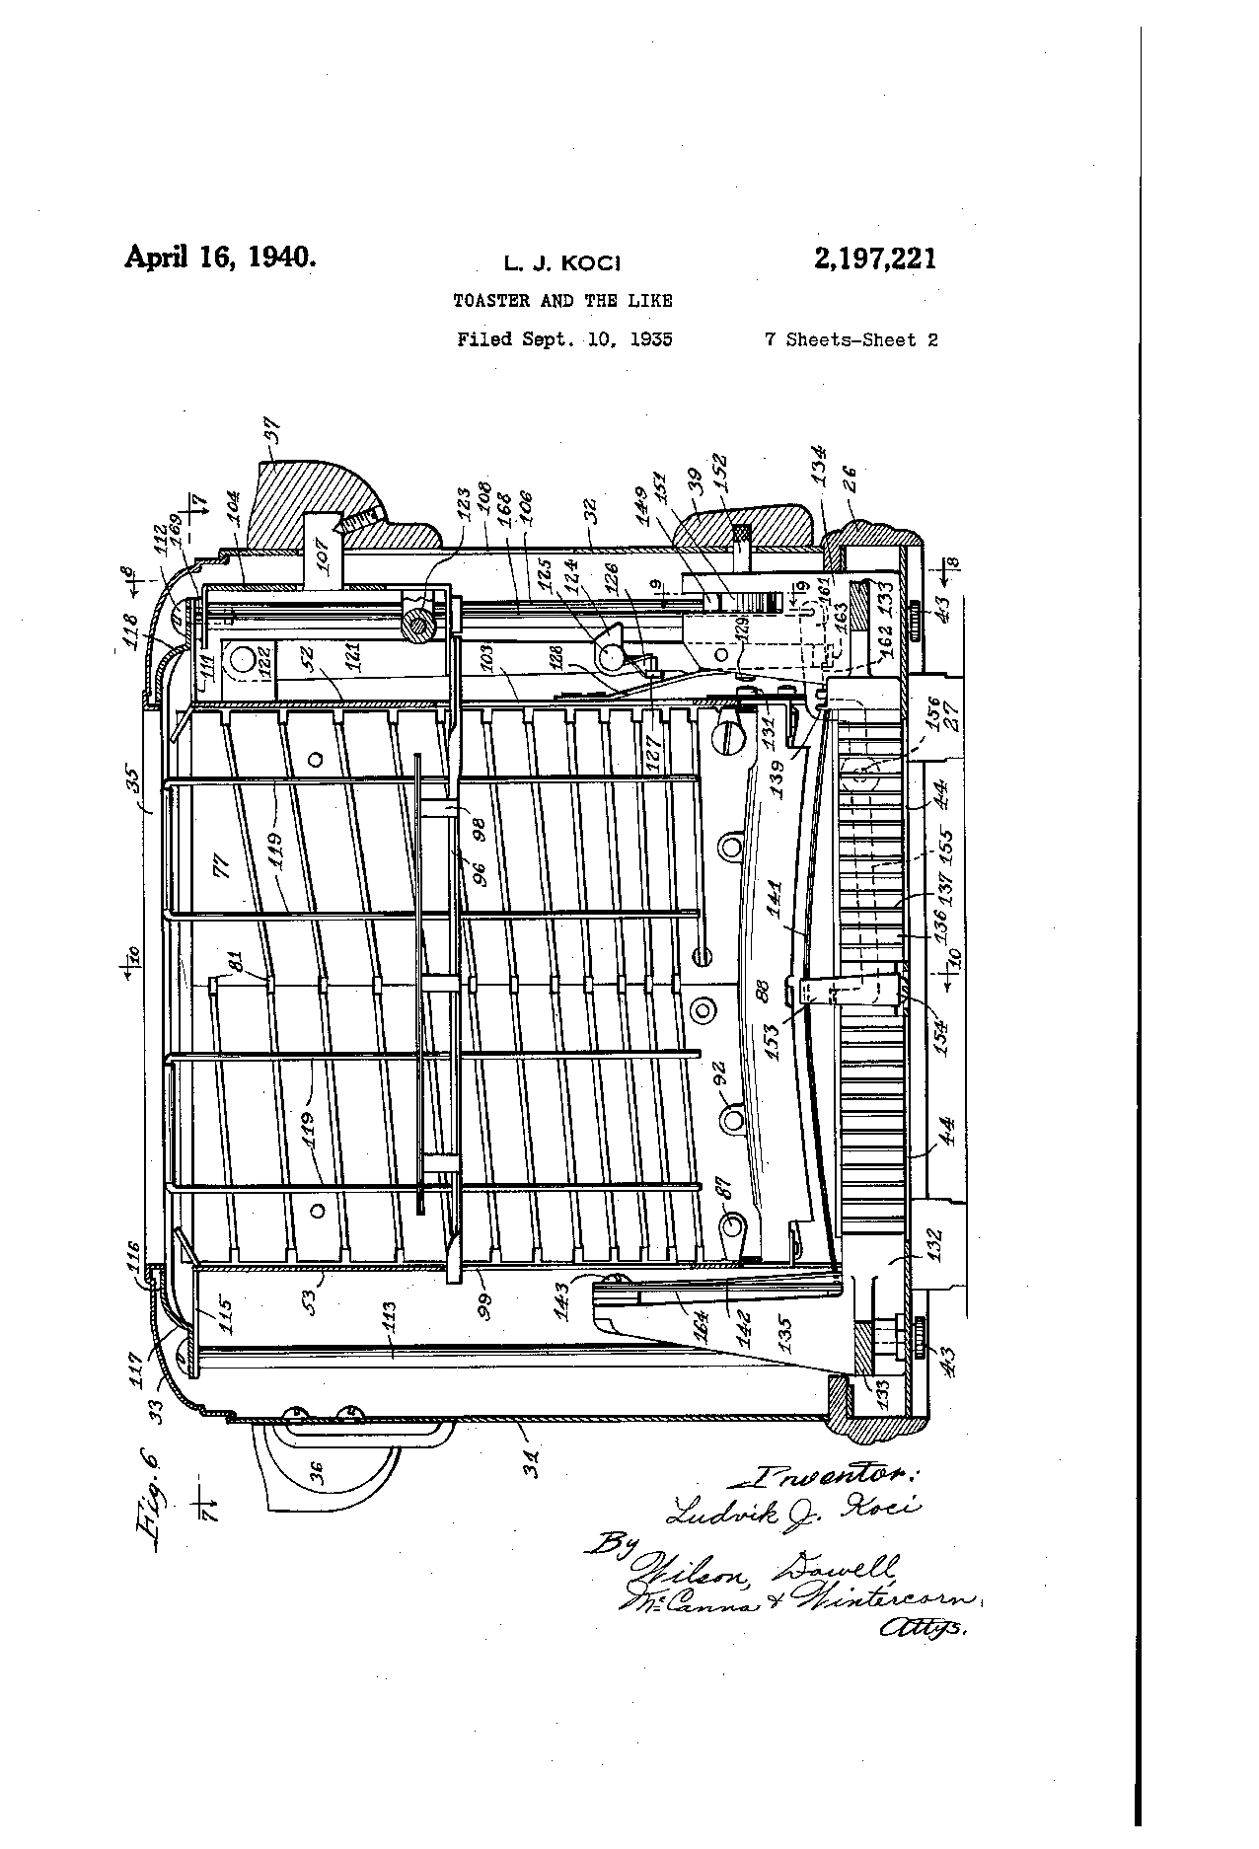
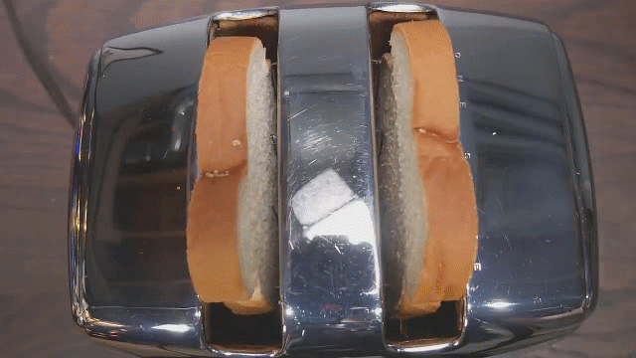
Courtesy of “The Antique Toaster that’s Better than Yours” video by
Technology Connections (youtu.be/1OfxlSG6q5Y)
Bimetallic strip

Slide 7
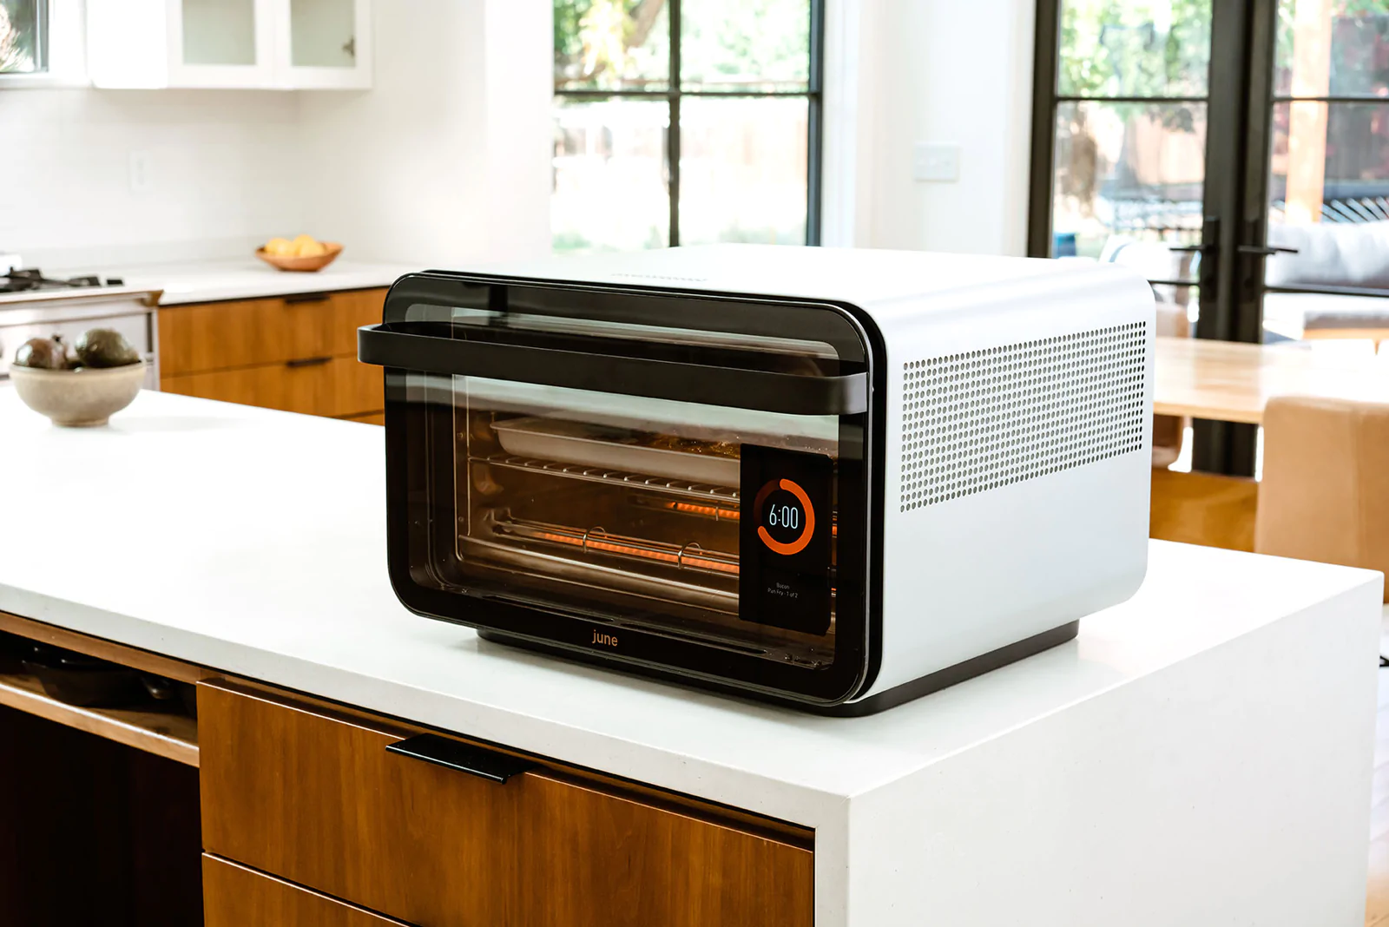
Camera
Courtesy of juneoven.com

Slide 8
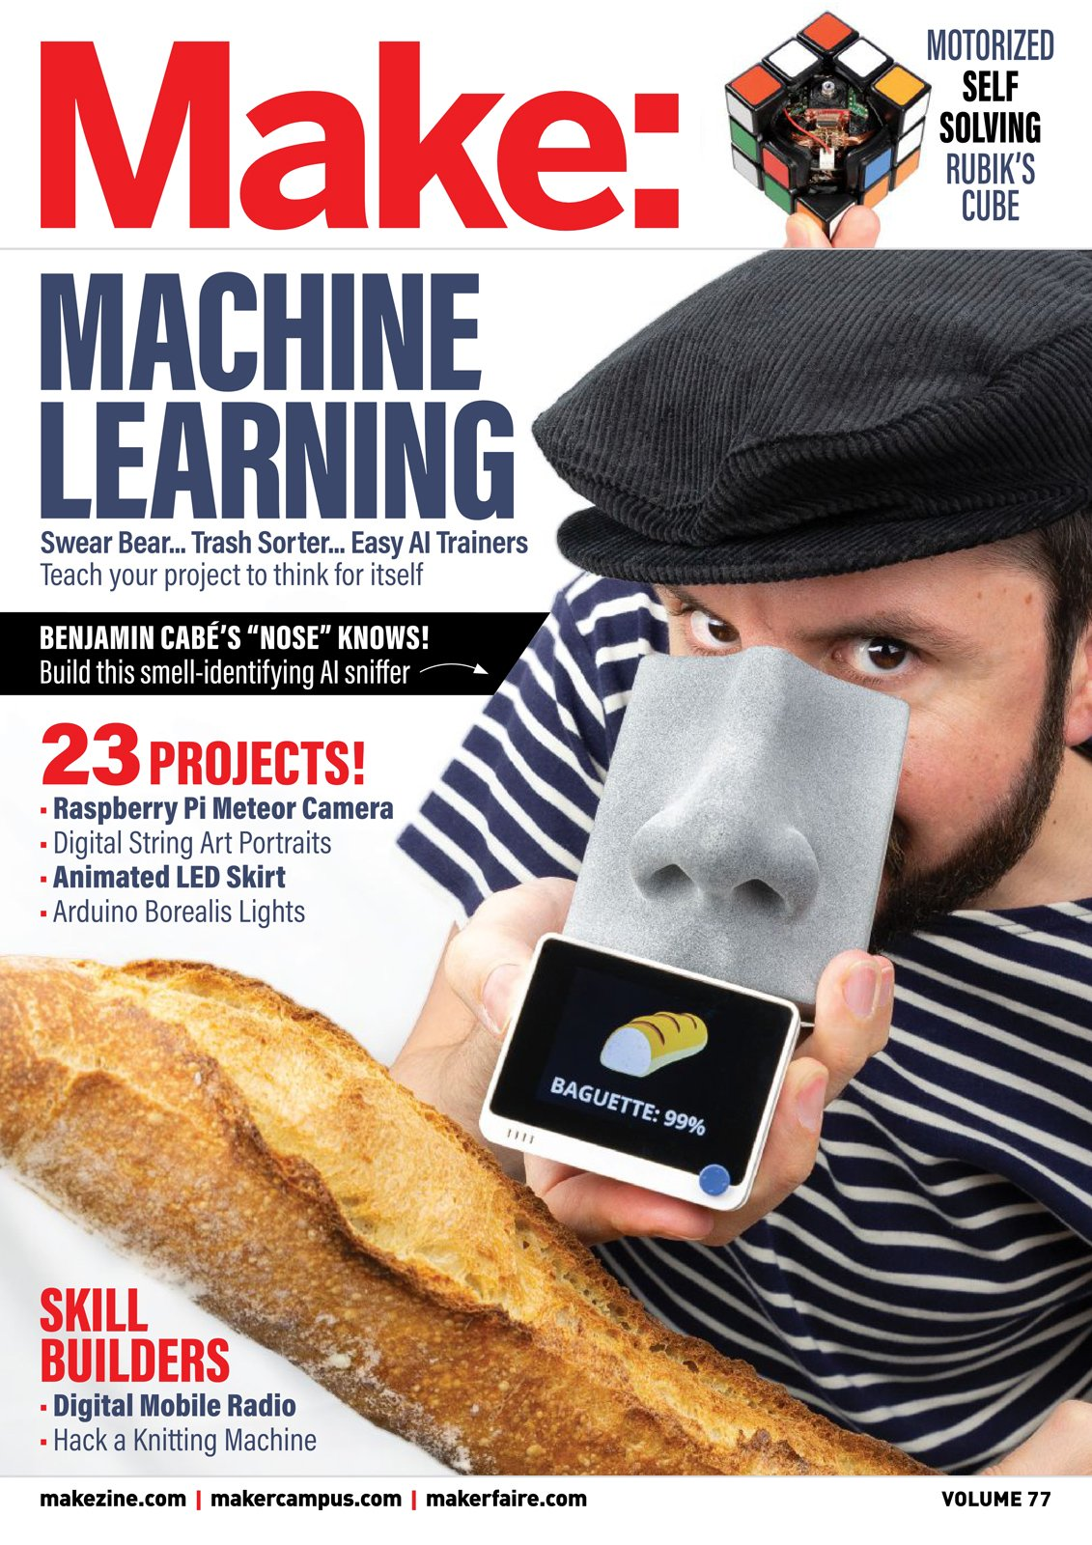

Slide 9
Stage 1
Data
Gas Sensors

Slide 10
Stage 2
Data
Machine Learning Model
Seconds until burnt

Slide 11
Stage 3
Controller
Machine Learning Model

Slide 12
Stage 4
fire
doneness
burnt
seconds
until burnt
time
Controller
Machine Learning Model

Slide 13
Stage 5
fire
doneness
burnt
seconds
until burnt
time
Controller
Machine Learning Model

Slide 14
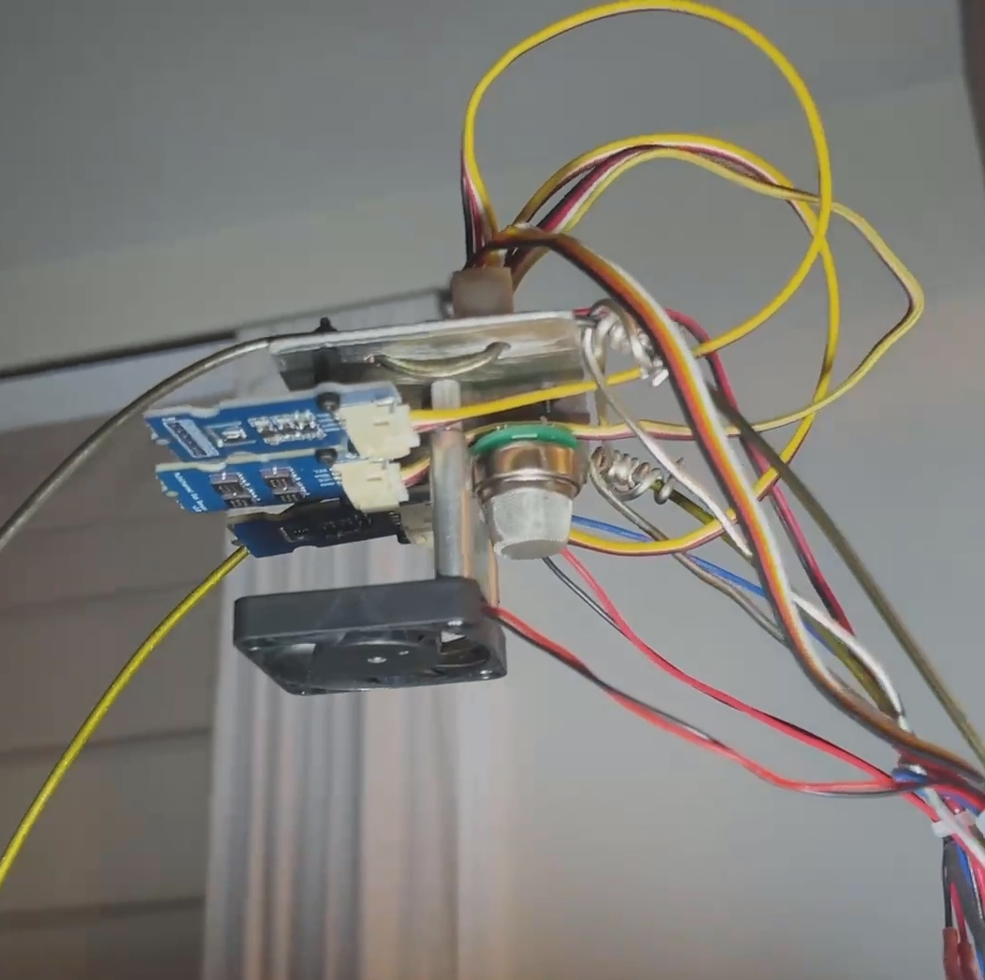

Slide 15
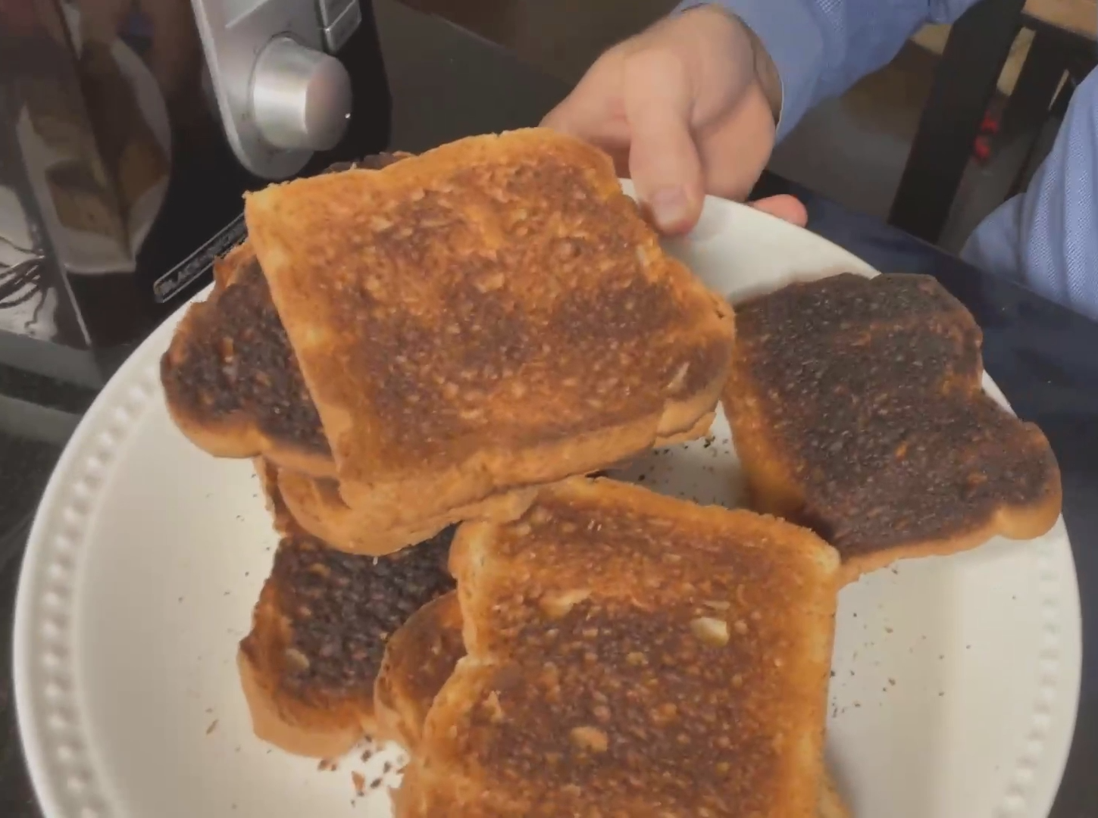

Slide 16
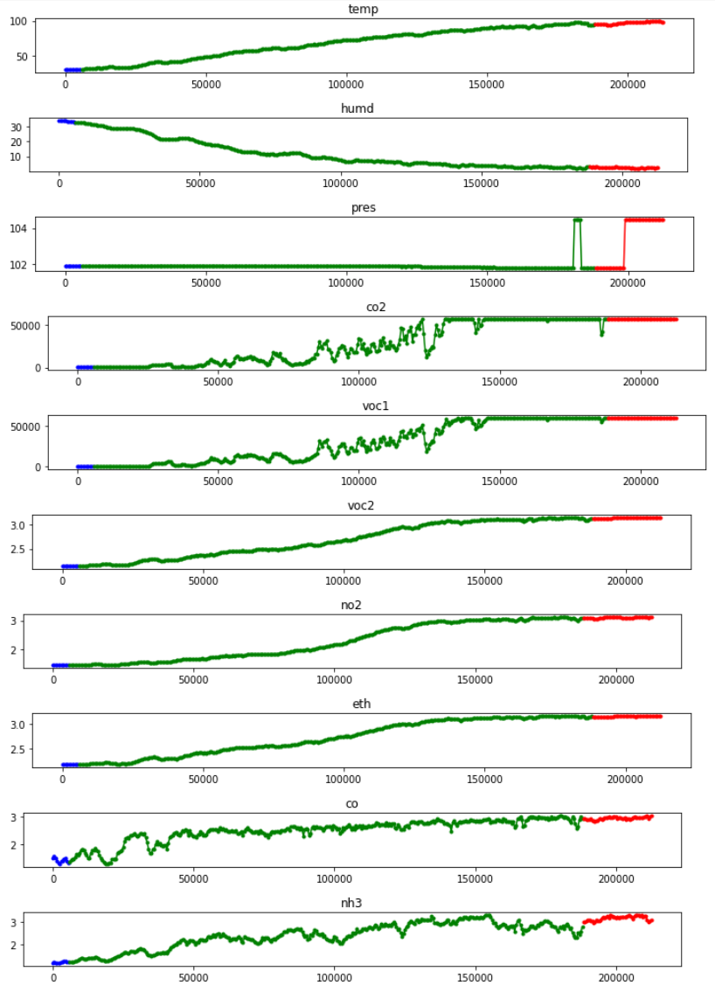

Slide 17
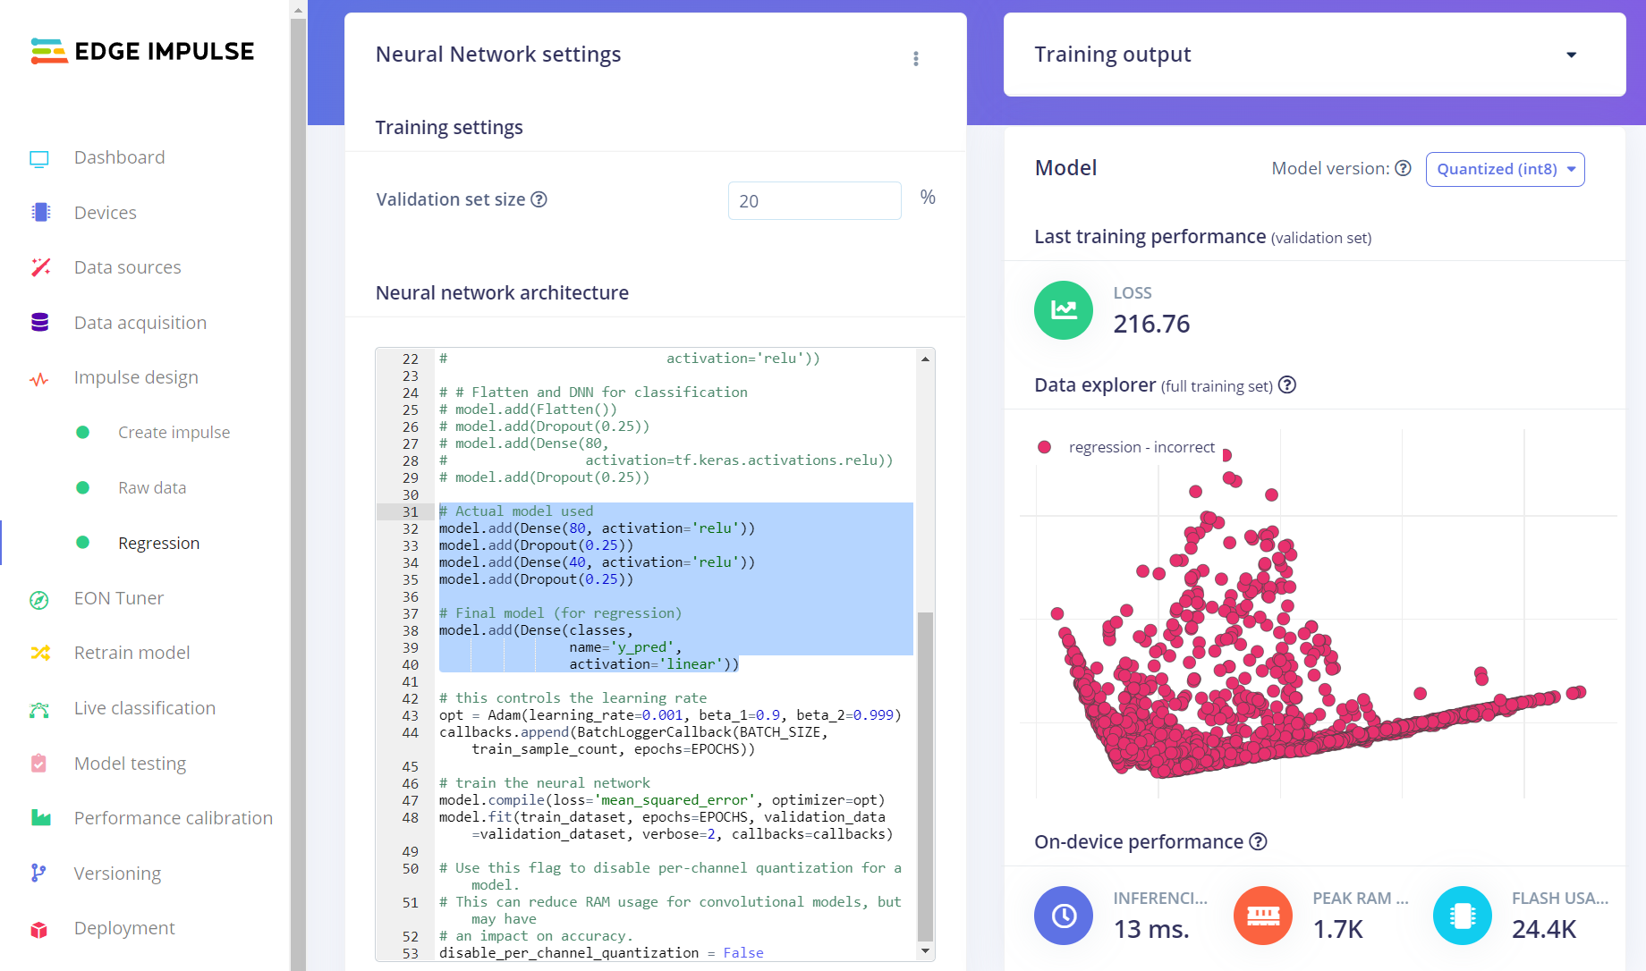

Slide 18
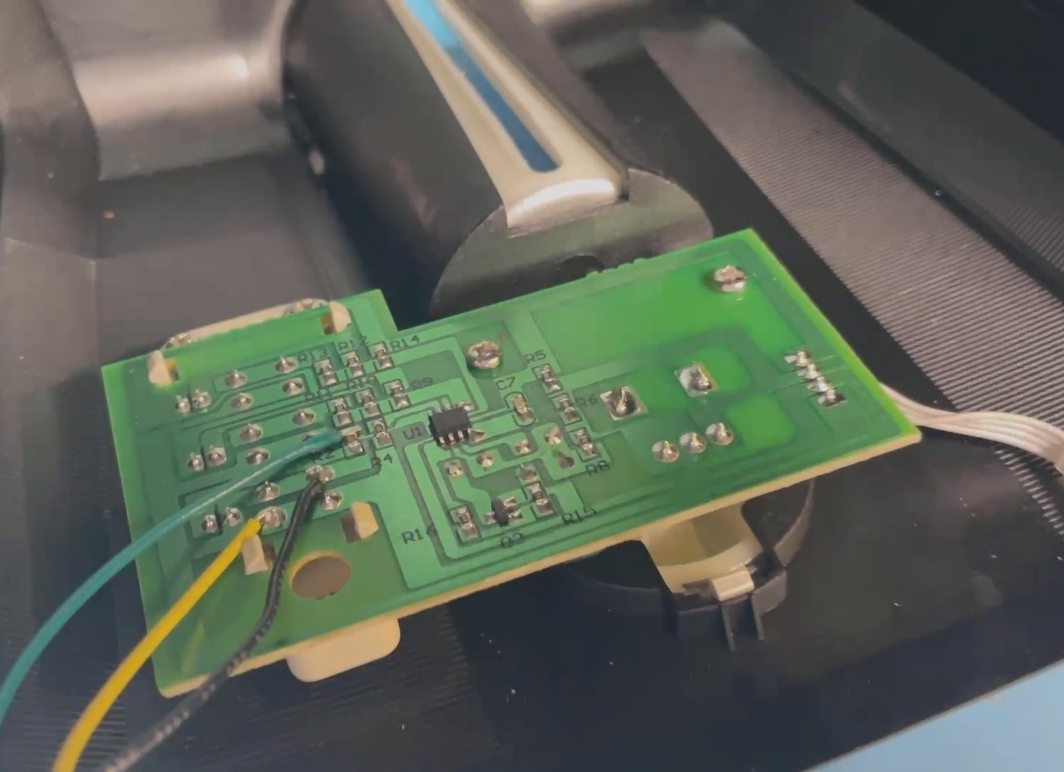

Slide 19
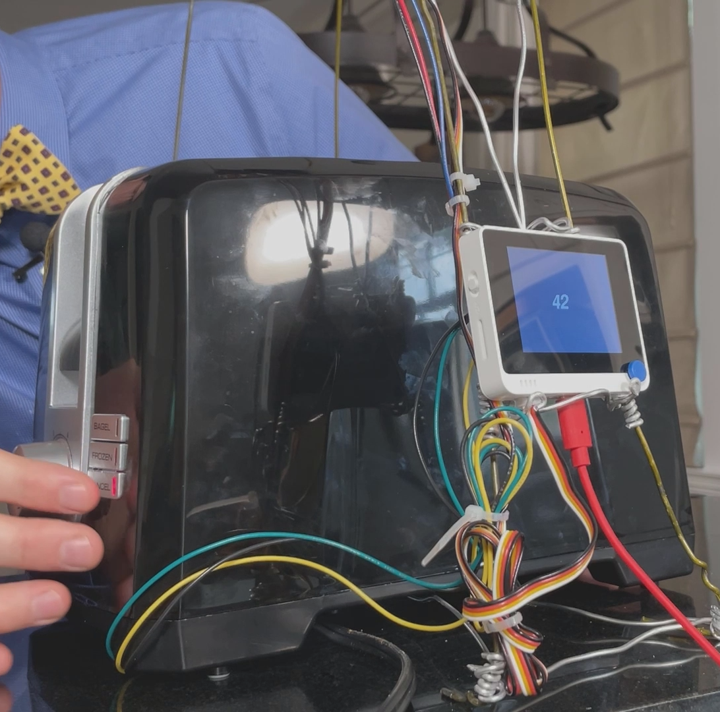
Predicted number of seconds until burnt

Slide 20
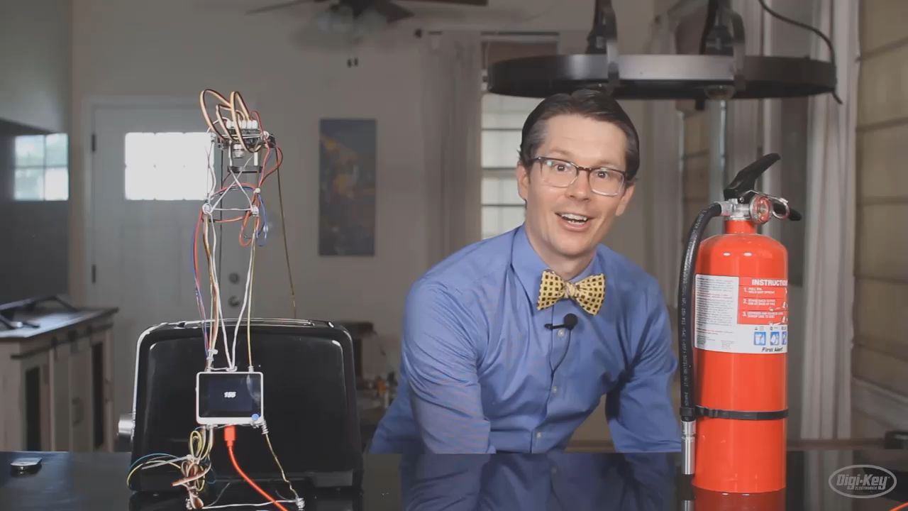

Slide 21






Tell me more
github.com/ShawnHymel/
perfect-toast-machine
@shawnhymel@masto.ai
github.com/edgeimpulse
@ShawnHymel
@EdgeImpulse
in/shawnhymel
company/edgeimpulse
shawn_hymel

